Slide 1
Building Interactive Interfaces

Slide 2

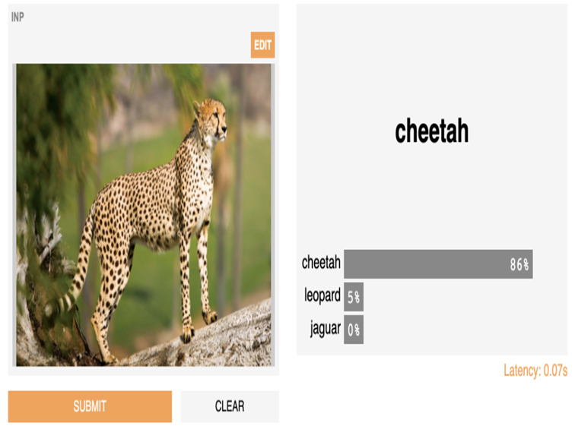

Building Interactive Interfaces
Image Classification

Slide 3
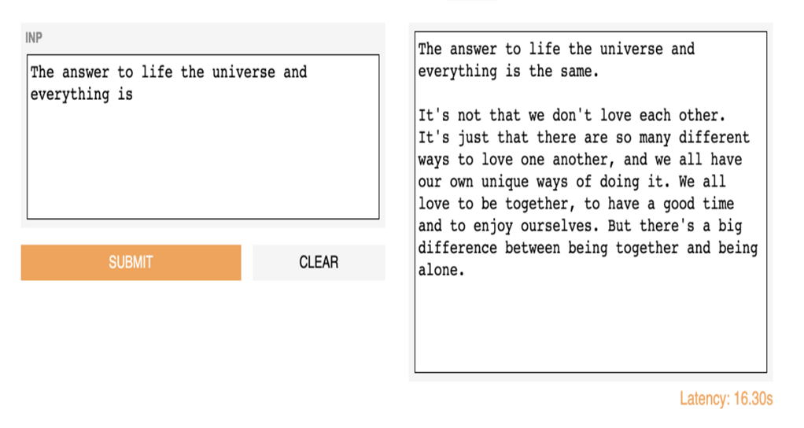
Building Interactive Interfaces
Text Generation with Transformers (GPT-2)

Slide 4
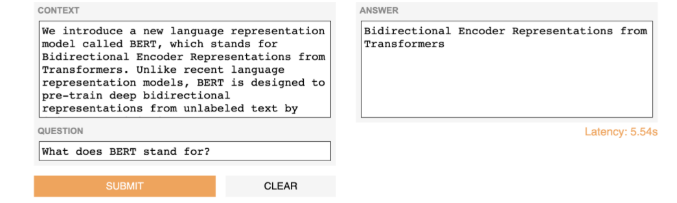
Building Interactive Interfaces
Answering Questions With BERT-QA

Slide 5

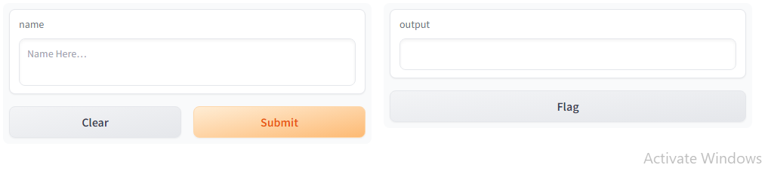
The Interface

Slide 6




The Interface : The interface class has three parameters
Gradio.interface(fn, input, output)
fn: (Callable)the function to wrap an interface.
inputs: (Union[str, List[Union[str, AbstractInput]]]) a single Gradio input component, or list of Gradio input components.
outputs: a single Gradio output component, or list of Gradio output components.
live: (bool) whether the interface should automatically reload on change.
capture session: (bool) if True, captures the default graph and session
title: (str) a title for the interface; if provided, appears above the input and output components.
description: (str) a description for the interface; if provided, appears above the input and output components.
examples: sample inputs for the function

Slide 7

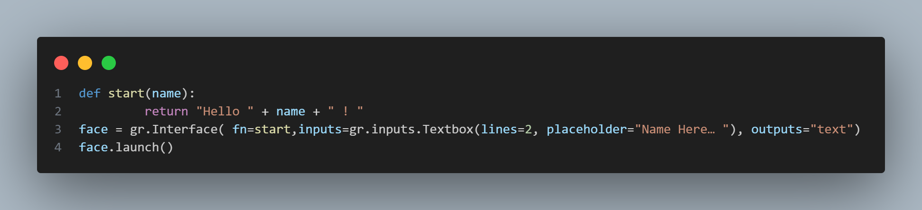
The Interface

Slide 8
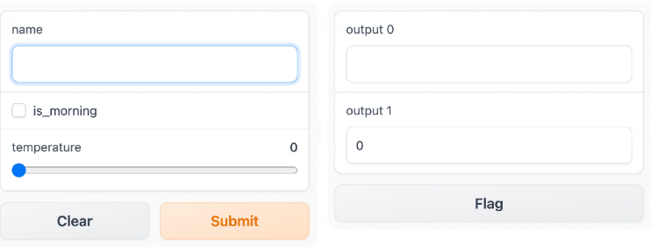
Multiple Input and Output Components

Slide 9
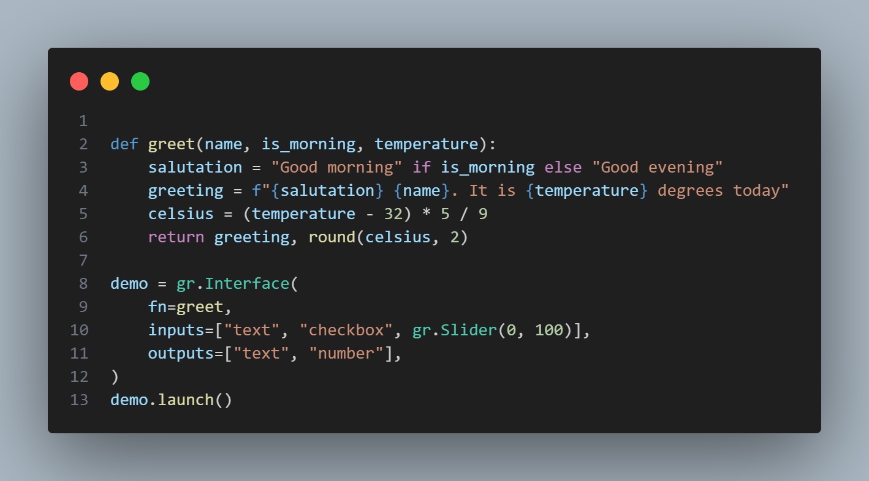
Multiple Input and Output Components
Each component in the inputs list corresponds to one of the parameters of the function, in order. Each component in the outputs list corresponds to one of the values returned by the function, again in order.

Slide 10
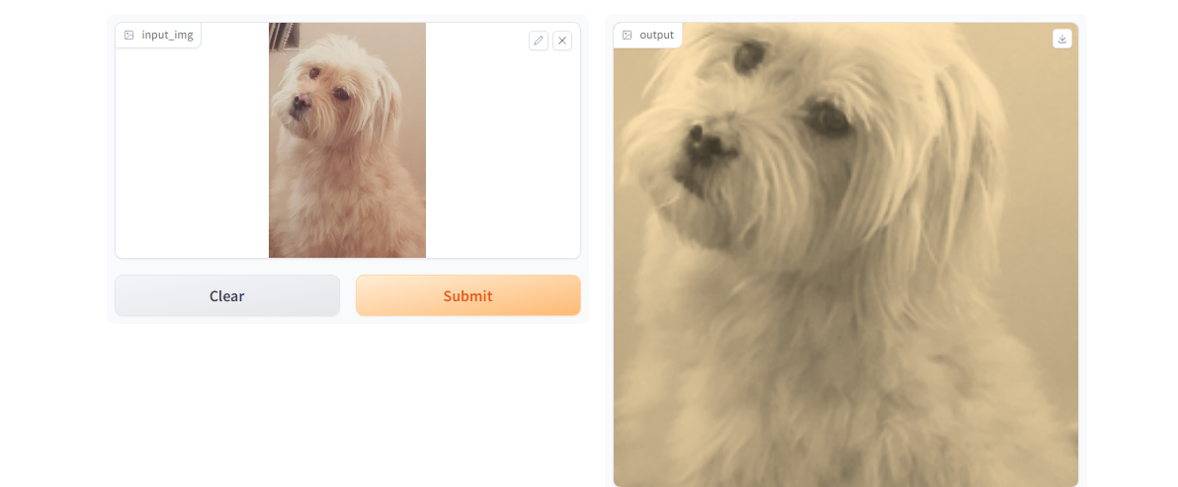
Multiple Input and Output Components

Slide 11
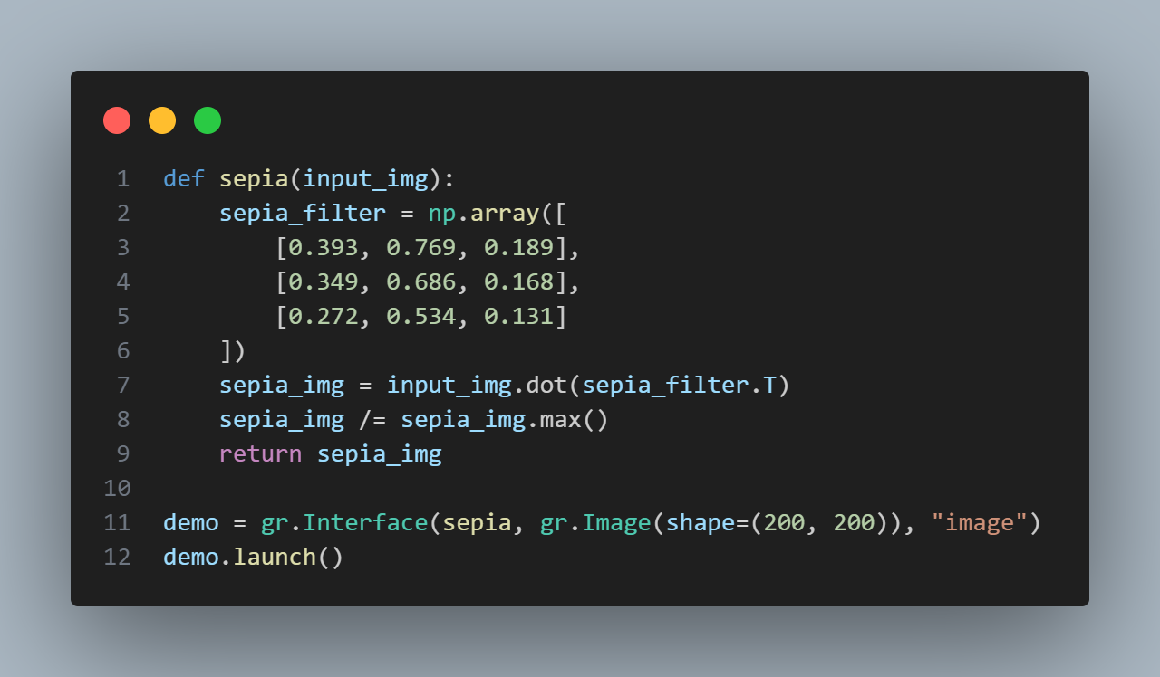
Multiple Input and Output Components
gr.Image(type="filepath", shape=...)

Slide 12
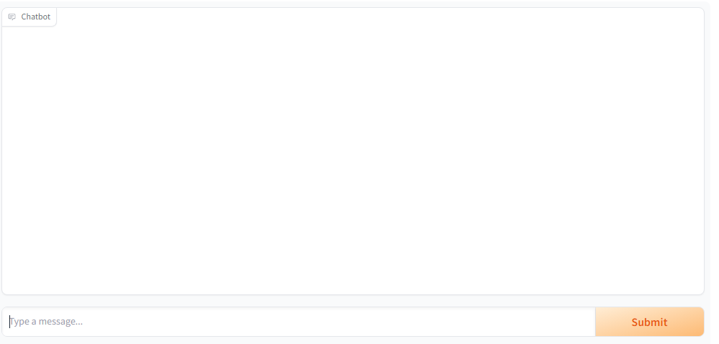
Multiple Input and Output Components

Slide 13
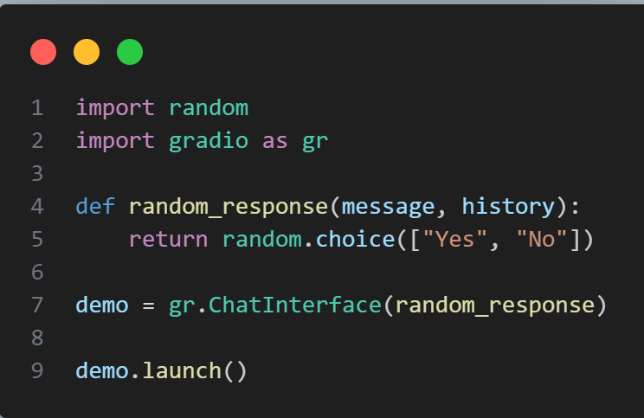
Multiple Input and Output Components: Chatbots
gr.ChatInterface is specifically designed for Chabot Uis
The function should take two arguments:
Message: a str representing the user's input
History: a list of list representing the conversations up until that point. Each inner list consists of two str representing a pair: [user input, bot response].

Slide 14
Blocks: More Flexibility and Control
Gradio approaches to build apps:
1. Interface and ChatInterface.
2. Blocks
Block:
a low-level API for designing web apps with more flexible layouts and data flows.
Block:
allows you to do things like feature multiple data flows and demos, control where components appear on the page,
handle complex data flows (e.g. outputs can serve as inputs to other functions)
update properties/visibility of components based on user interaction — still all in Python.
If this customizability is what you need, try Blocks instead!

Slide 15
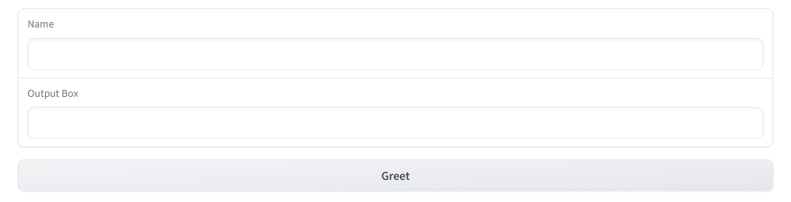
Blocks: More Flexibility and Control
Greeting by block:
Greeting by interface

Slide 16
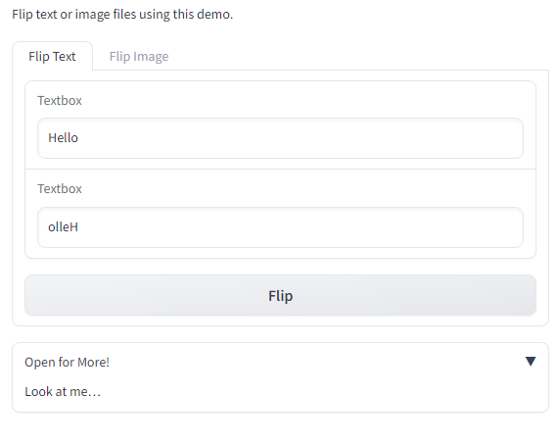
Blocks: More Flexibility and Control

Slide 17

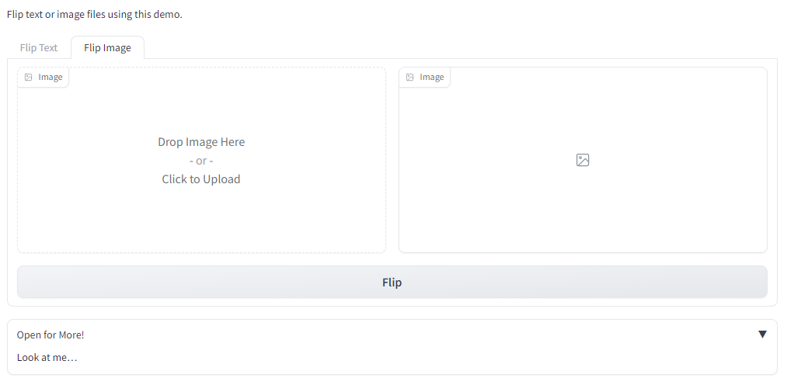
Blocks: More Flexibility and Control

Slide 18
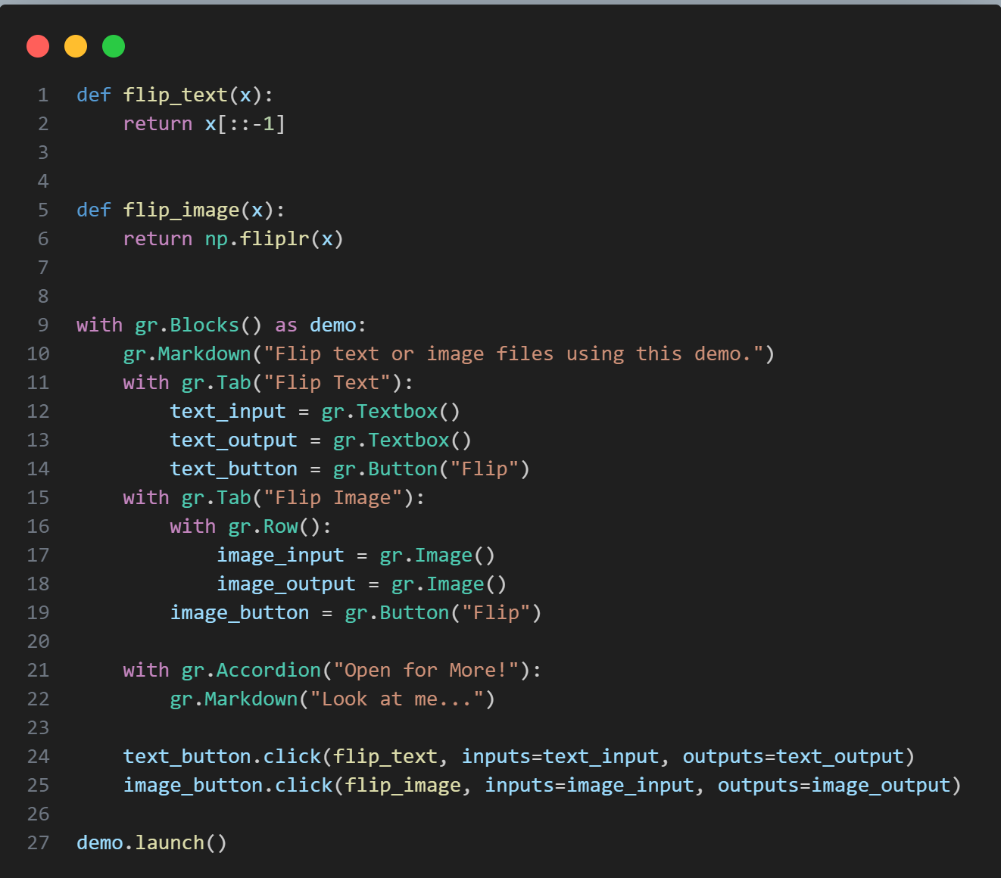
Blocks: More Flexibility and Control

Slide 19
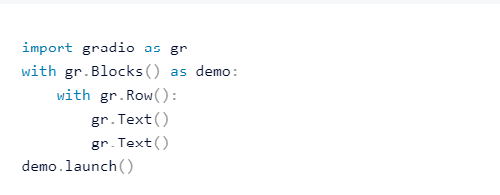
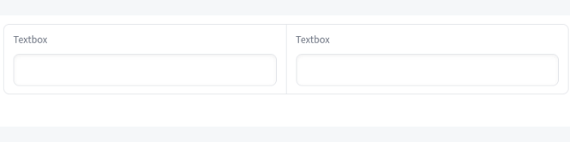
Laying out your Gradio application
The layout of the application's blocks can be customized using layout classes like :
gradio.Row(),

Slide 20
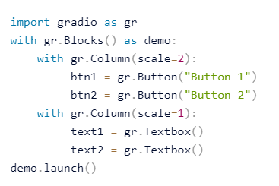
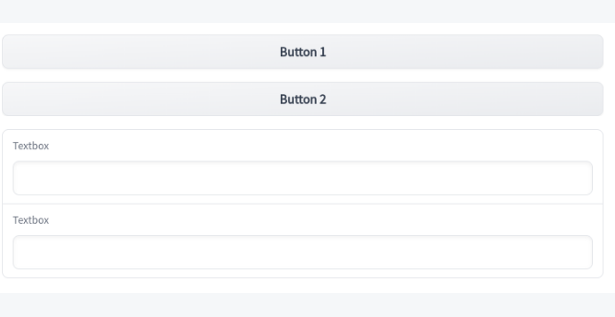
Laying out your Gradio application
gradio.Columns(),

Slide 21
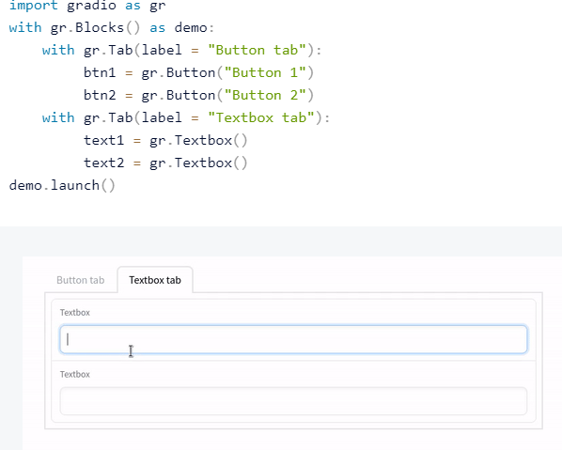
Laying out your Gradio application
gradio.Tab(),

Slide 22



Connecting Model to Gradio

Slide 23
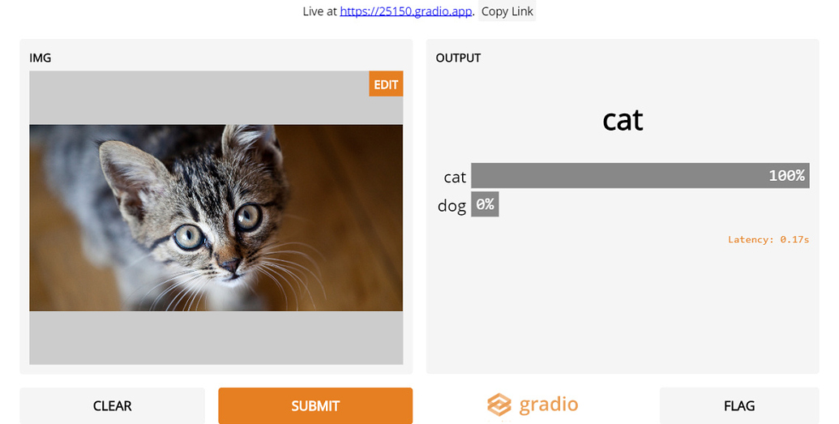
Cat-Dog Image classification

Slide 24
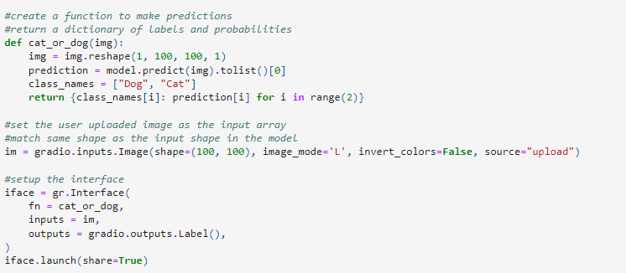
Cat-Dog Image classification

Slide 25
Deploy a Machine Learning Model on Gradio
Images
&
Computer Vision Demo
Audio
&
Speech
Image segmentation
Image generation
Text to Speech
Speech to text
Speaker verification

